Slide 1

HRT Paratransit Rider App
August 2020

Slide 2

Welcome!
Introduction.
Current vs. future features
Exploring the rider app.

Slide 3

This is an iterative process
The outcome
Continually release new app versions.
Versions aren’t perfect.
Receive as much customer feedback as possible and quickly create new versions.
An app user experience that is:
Customer-centric.
Clear and easy to use.
ADA Compliant.

Slide 4

What’s in this version of the app?
Features we think you’ll love
Track the location of your vehicle leading up to your pickup time.
View, modify, or cancel your scheduled rides.
Book one-time trips / round trips.
View the route of your ride and expected drop-off time.
Multiple proposals (when available) for you to select the time window that works best for you.
Payment method management

Slide 5
What’s coming soon?
New in version 2
Book recurring trips.
Working voiceover functionality during book ride flow
Feedback from you!

Slide 6
Getting Started - Download and First-time Login

Slide 7
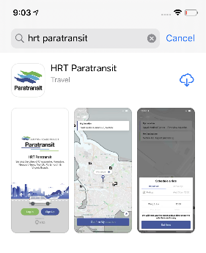
Downloading the app
For iPhone and Android users:
You can find the app in the store by searching “HRT Paratransit”

Slide 8

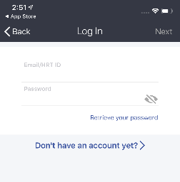
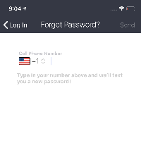
First time login process
If a rider uses the web portal - the password will remain the same for the app. Enter HRT ID & password to login.
Click “Log In”
Click “Retrieve your password”
Enter phone # (must match account)

Slide 9
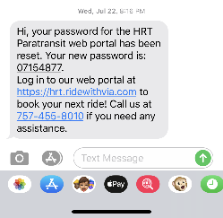
First time login process
Receive SMS and call w/ password
Return to Log In screen
HRT ID

Slide 10
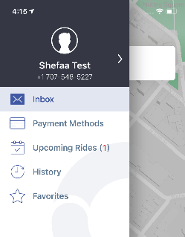
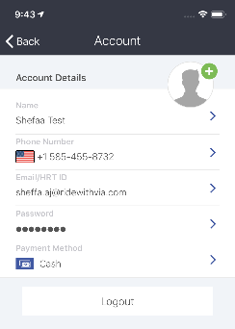
Update password to something you can easily remember (optional)
Make sure your password is at least 6 characters long and contains a number or special character.
Example acceptable password: ‘Hrt123’

Slide 11
Booking a one-time ride.

Slide 12
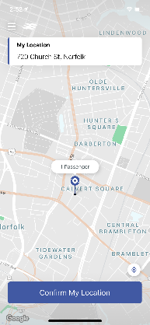
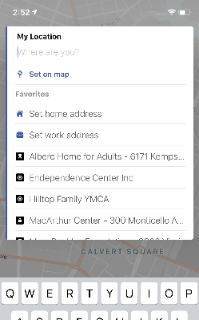
Step 1 - Pickup Location

Slide 13
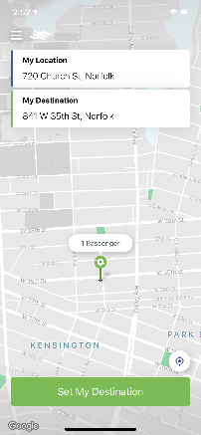
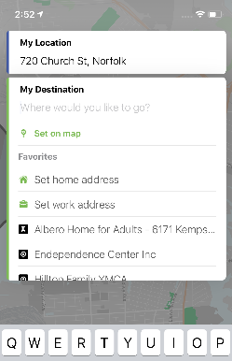
Step 2 - Destination Location

Slide 14
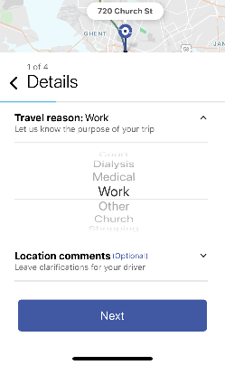
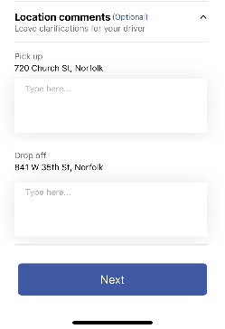
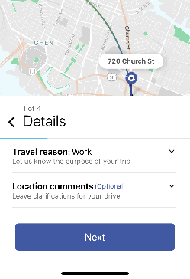
Step 3 - Travel Reason & Ride Notes

Slide 15
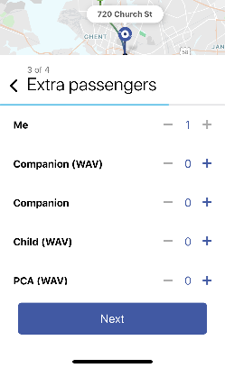
Step 4 - Additional Passengers

Slide 16
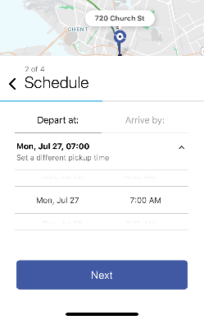
Step 5 - Date and Time
Choose “Depart at” or “Arrive by”

Slide 17
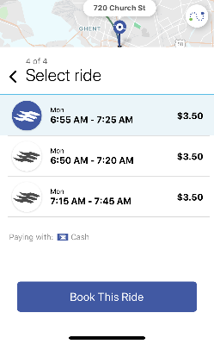
Step 6 - Select Proposal Window

Slide 18
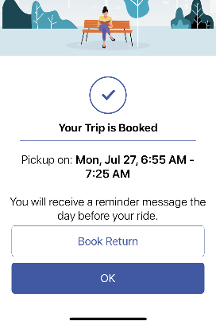
Step 7 - Confirmation Screen + Book Return
“Book Return” flips the pickup and destination locations and starts the booking process again. Rider still needs to go through ride details (date, time, etc.) and confirm.

Slide 19
Other key app functionality

Slide 20
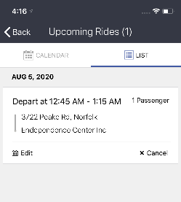
View, Edit, or Cancel Rides

Slide 21
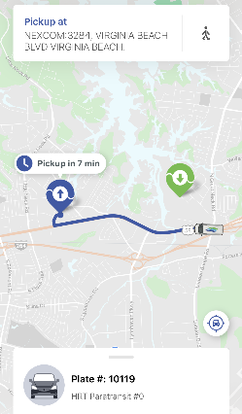
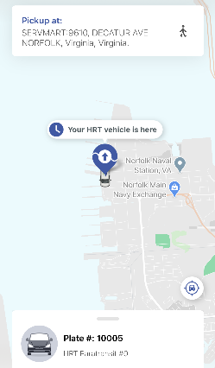
Track the real time location of your driver.

Slide 22
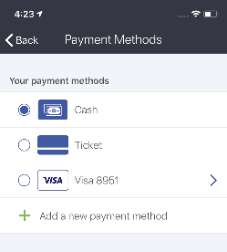
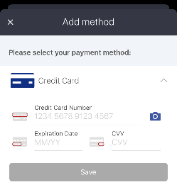
Update a payment method

Slide 23
Thank you!
Added by Endependence Center – information on HRT website about App
https://gohrt.com/paratransit/app/

